Slide 1

Note: The data and information in this document is reflective of a hypothetical situation and client. This document is to be used for KPMG Virtual Internship purposes only.
Sprocket Central Pty Ltd
Data analytics approach
[Division Name] - [Engagement Manager], [Senior Consultant], [Junior Consultant]

Slide 2
Note: The data and information in this document is reflective of a hypothetical situation and client. This document is to be used for KPMG Virtual Internship purposes only.
Agenda
Introduction
Data Exploration
Model Development
Interpretation

Slide 3
Note: The data and information in this document is reflective of a hypothetical situation and client. This document is to be used for KPMG Virtual Internship purposes only.
Introduction
In a dynamic business environment, data-driven insights are vital, and we're committed to delivering just that. With your agreement on a 3-week timeline, split into Data Exploration, Model Development, and Interpretation phases, we're ready to embark on a journey of understanding, innovation, and actionable outcomes. Join us as we outline our strategy to uncover valuable insights and provide recommendations that can shape your success..

Slide 4
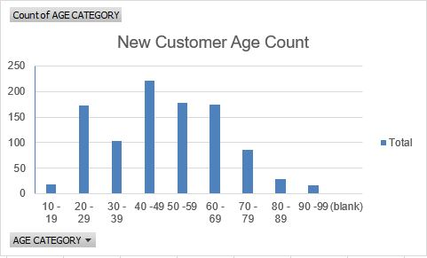
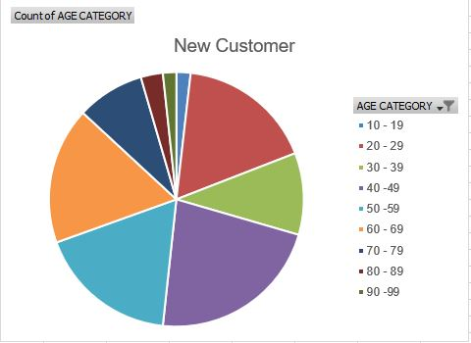
Note: The data and information in this document is reflective of a hypothetical situation and client. This document is to be used for KPMG Virtual Internship purposes only.
Data Exploration
Age Distribution for New Customers:

Slide 5
Note: The data and information in this document is reflective of a hypothetical situation and client. This document is to be used for KPMG Virtual Internship purposes only.
Data Exploration
Analysis - Age Distribution
Plots show that the majority of new customers are between the ages of 40 and 49, which is consistent with previous customer data. Thus, we conclude that people in this age group are most likely to make frequent purchases.
In the most recent customer data, the ratio of purchases has increased for customers between the ages of 60 and 69.
For the age range of 20 to 29, the data distribution is the same in both sets of data.
The proportions of people under 25 seem to have barely changed.

Slide 6
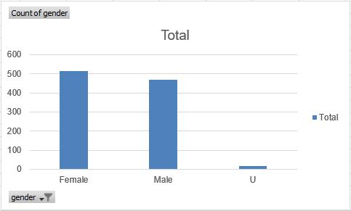
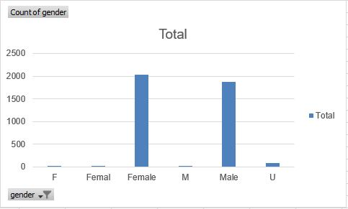
Note: The data and information in this document is reflective of a hypothetical situation and client. This document is to be used for KPMG Virtual Internship purposes only.
Model Development
NEW CUSTOMER PURCHASE
Purchase History of Bikes (last 3 years)
Approximately 51% of women (25,212 bikes) and 47% of men (23,765 bikes) respectively purchased bicycles in the past three years, according to the data.
Our marketing and advertising should focus more on females than on males as the target audience.
OLD CUSTOMER PURCHASE

Slide 7
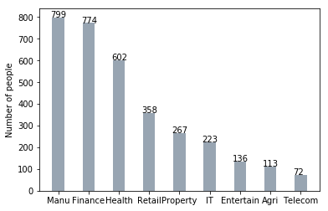
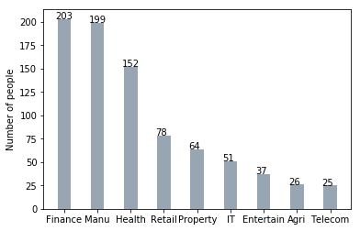
Note: The data and information in this document is reflective of a hypothetical situation and client. This document is to be used for KPMG Virtual Internship purposes only.
Interpretation
Job industry
The finance sector accounts for the majority of the new clients, and manufacturing clients continue to hold one of the top two spots.
The remaining industries appear to be in the same positions.

Slide 8
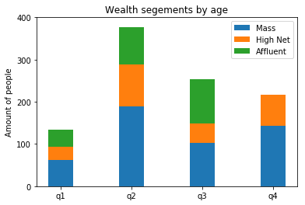
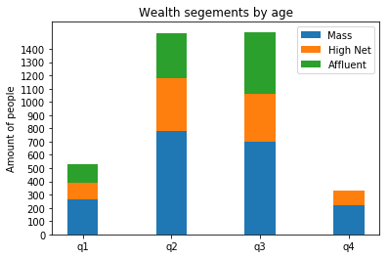
Note: The data and information in this document is reflective of a hypothetical situation and client. This document is to be used for KPMG Virtual Internship purposes only.
Interpretation
Wealth segment
Mass Customers continue to represent the majority of customers across all age groups, so it makes sense to give this area more attention.
The High Net Customer Category should be the next area of focus.
The wealthy clients came after that.

Slide 9
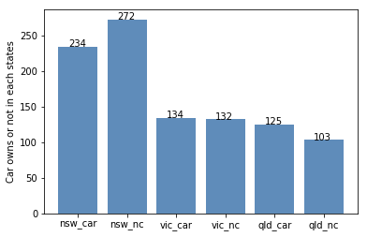
Note: The data and information in this document is reflective of a hypothetical situation and client. This document is to be used for KPMG Virtual Internship purposes only.
Interpretation
Wealth segment
NSW should be taken into consideration because VIC and QLD cars seem to have more customers who own cars.
Given that a greater proportion of customers don't own a car than do, the NSW cars category should currently receive the highest priority.

Slide 10
Note: The data and information in this document is reflective of a hypothetical situation and client. This document is to be used for KPMG Virtual Internship purposes only.
THANK YOU

